Slide 1

Introduction to NVIDIA stock
ST: Machine Learning and Python In Finance
Names:
Parag (001443264)
Suprita (001490723)
Rushi (001023379)
Akshay (001446491)
Yash

Slide 2



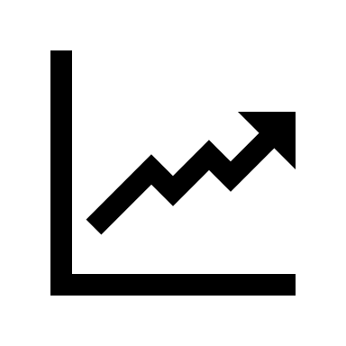


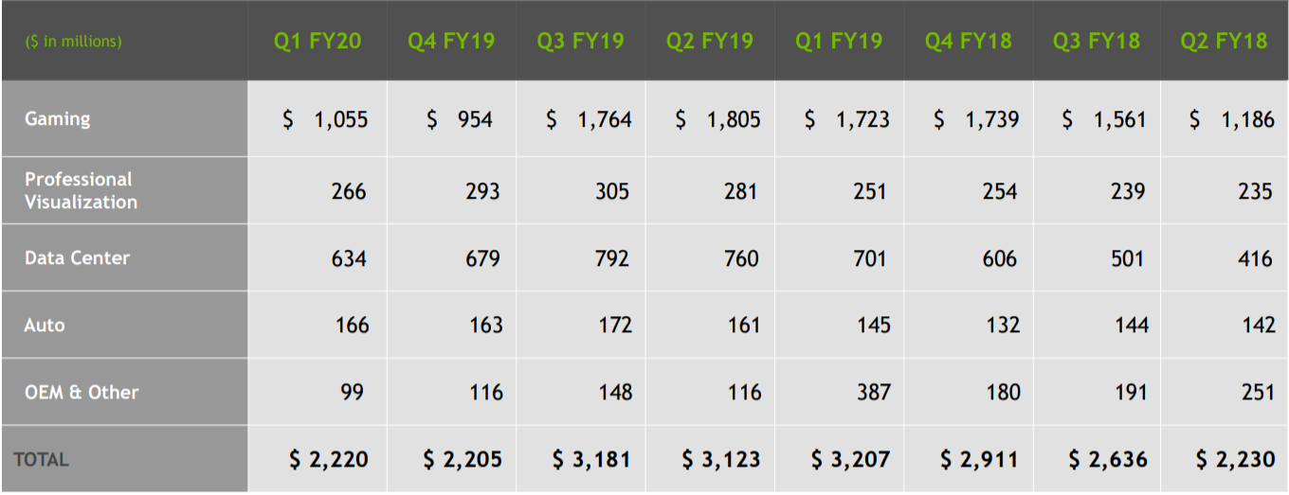
Why NVDIA
MARKET CAP $214.8B
DIVIDEND PER SHARE: $0.64
PRICE-EARNINGS RATIO: 63.12
52 WEEK
HIGH: $380
LOW: $143.65
AVG: $227.91
QUARTERLY EARNING GRAPH
ANALYST FORCAST 35% GROWTH ANNUALY

Slide 3
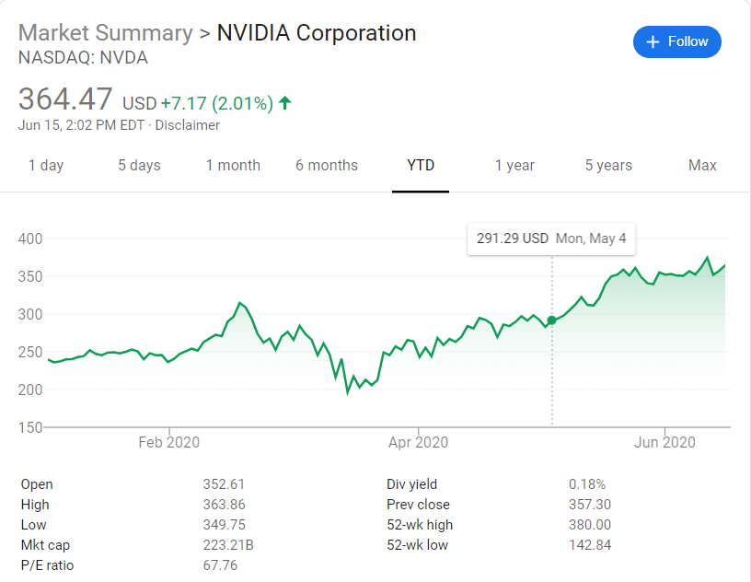
NVDA Stock- Past Return Index
Year to date stock
Current P/E ratio higher than
SP500-IT
High Revenue generating
company regardless of current
financial strain
Notes:
2 min short introduction on the past and present of the asset you trade. Demonstrate your deep understanding about the market.

Slide 4
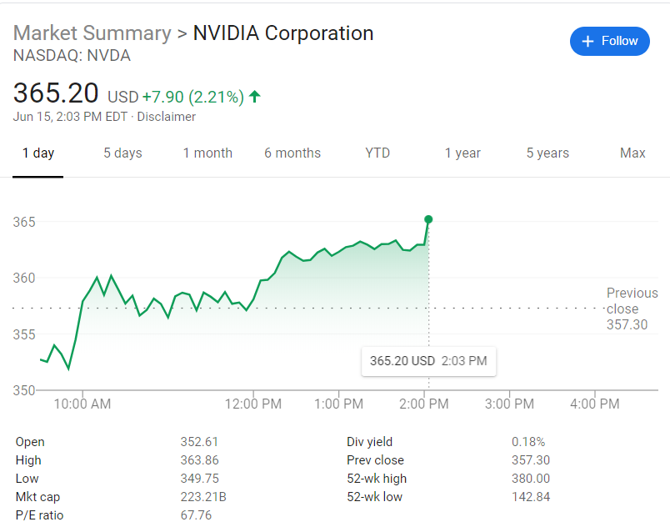
NVDA Stock Present Return Index
Even with the current COVID-19 situation we can see that the company EPS for the quarter ending April 30, 2020 was $1.47, a 129.69% increase year-over-year.
NVIDIA shares outstanding for the quarter ending April 30, 2020 were 0.622B, a 0.97% increase year-over-year.
Analyst say that NVDA is ‘Entering into Beast Mode’

Slide 5
To begin with we are considering NVIDIA stock prices for at most 2 years, ranging from 2016 to 2018
Data Definition:
Date: Date of trading day
High: Highest Price of Stock on that day
Low: Lowest Price of Stock on that day
Open: Opening Price of Stock on that day
Close: Closing Price of Stock on that day
Volume: Number of shares or contracts traded in a security or an entire market during a given period.
Adj Close: Adjusted closing price amends a stock's closing price to accurately reflect that stock's value after accounting for any corporate actions
About Data

Slide 6
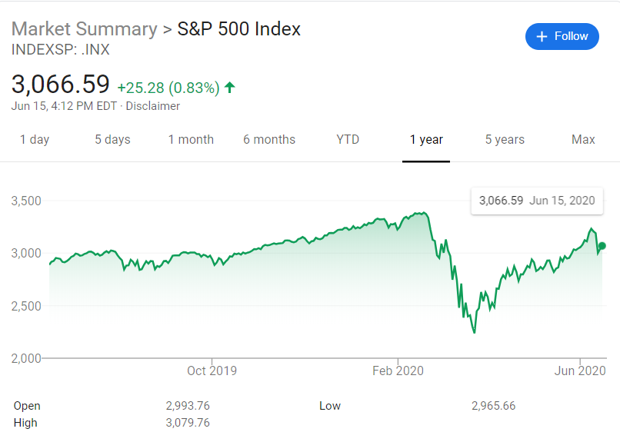
S&P-500
S&P 500- The S&P 500, or just the S&P is a stock market index that measures the stock performance of 500 large companies listed on stock exchanges in the United States. It is one of the most commonly followed equity indices, and many consider it to be one of the best representations of the U.S. stock market.
NVDA Stock prices correlate with S&P 500 Data
S&P Open- Cumulative opening price of all S&P 500
S&P Close - Cumulative closing price of all S&P 500
S&P High- Cumulative high price of all the S&P 500
S&P Low- Cumulative low price of all the S&P 500

Slide 7
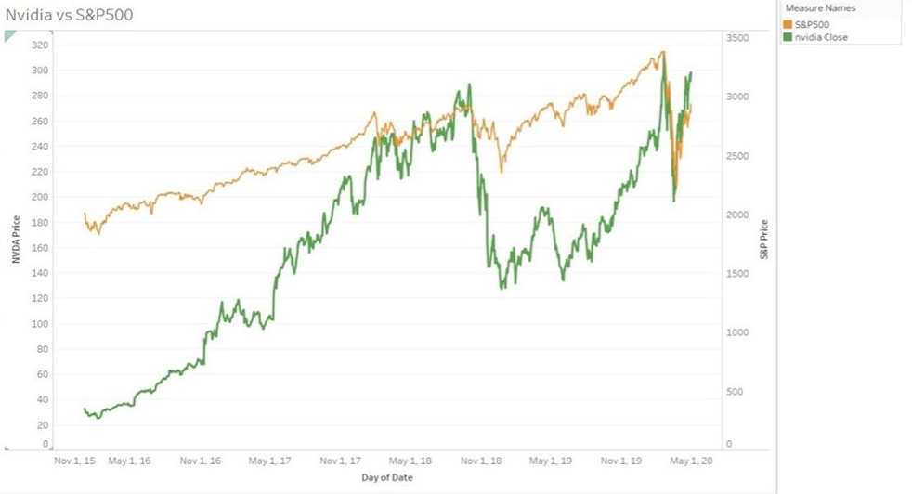

Slide 8
ADS-Index: The Aruoba-Diebold-Scotti business conditions index is designed to track real business conditions at high observation frequency. The average value of the ADS index is zero.
Progressively bigger positive values indicate progressively better-than-average conditions, whereas progressively more negative values indicate progressively worse-than-average conditions.
The ADS index may be used to compare business conditions at different times.
ADS Index

Slide 9
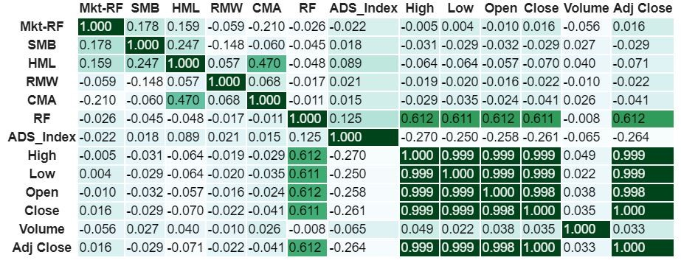
Exploratory Data Analysis
Notes:
Correlation Matrix between all the features that we have considered for PG Stock
Dark color represents max correlation between the features whereas the lighter colors represent minimum correlation.

Slide 10
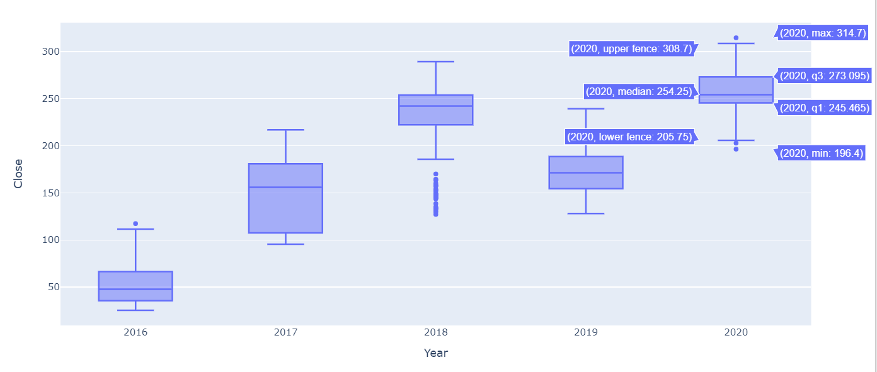
Box Plot of NVDA Closing Price Per Year

Slide 11
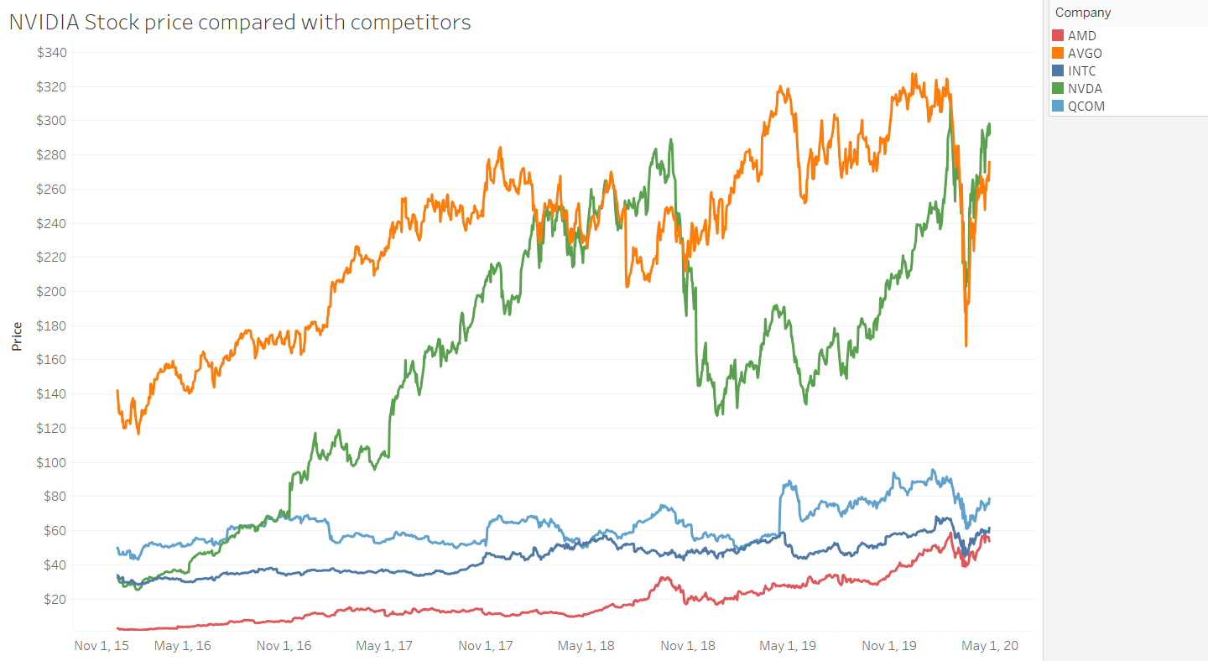
Graph Representing the Closing Price of NVDA with their Competitors

Slide 12
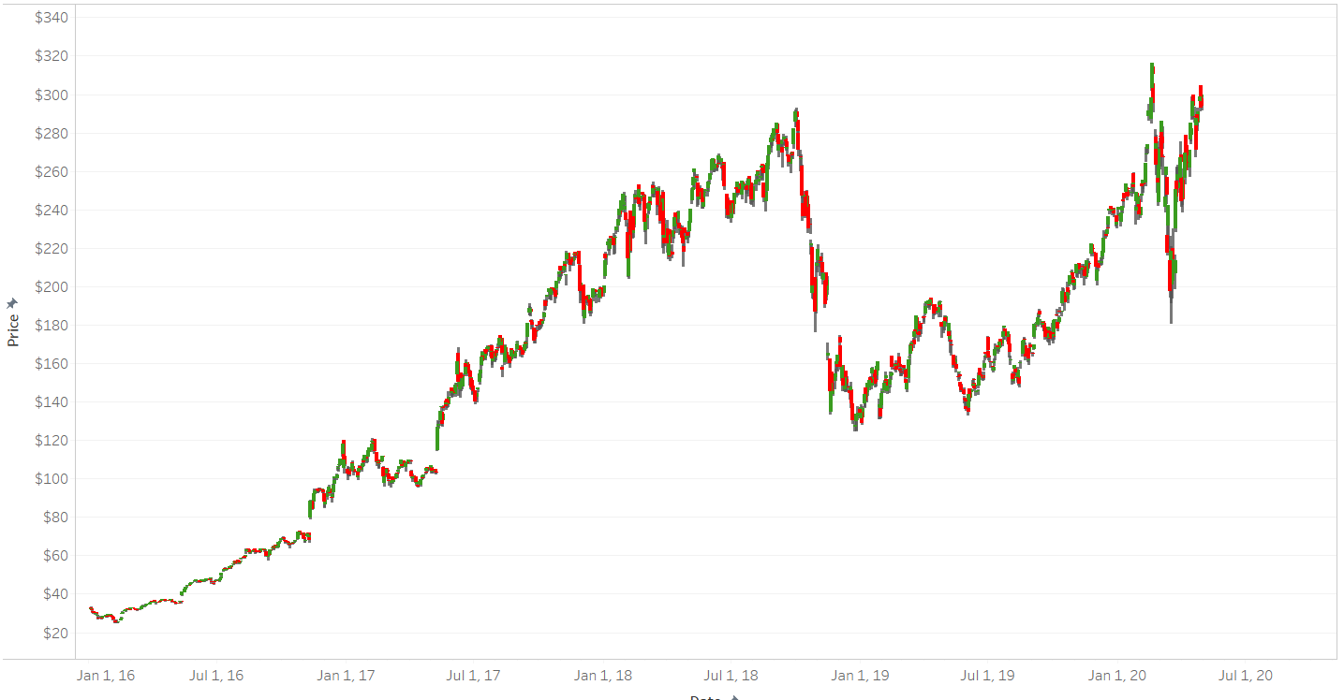
CandleStick Visualization

Slide 13
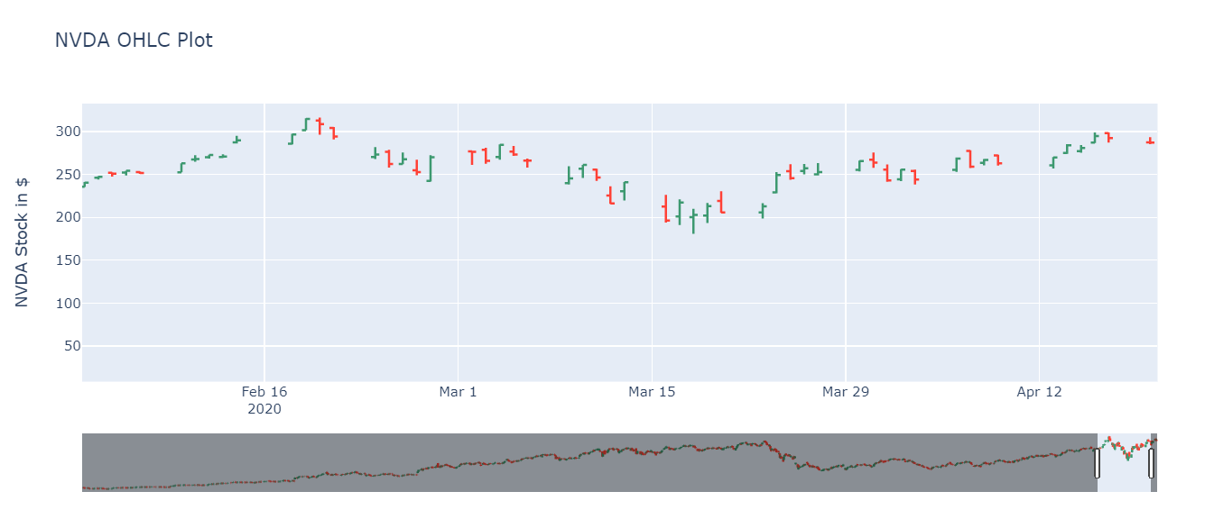
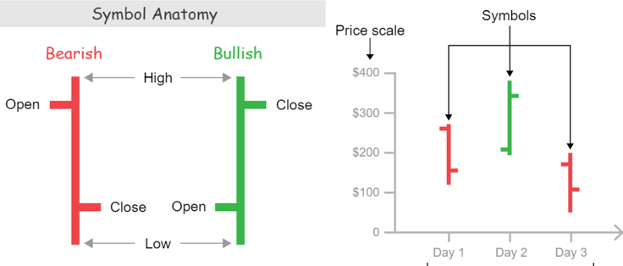
NVDA OHLC Plot

Slide 14
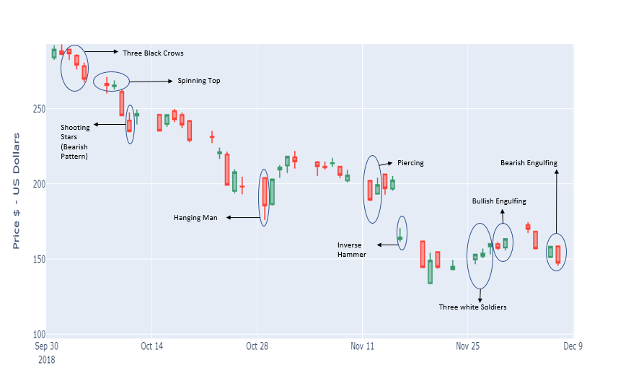
Candlestick Patterns

Slide 15
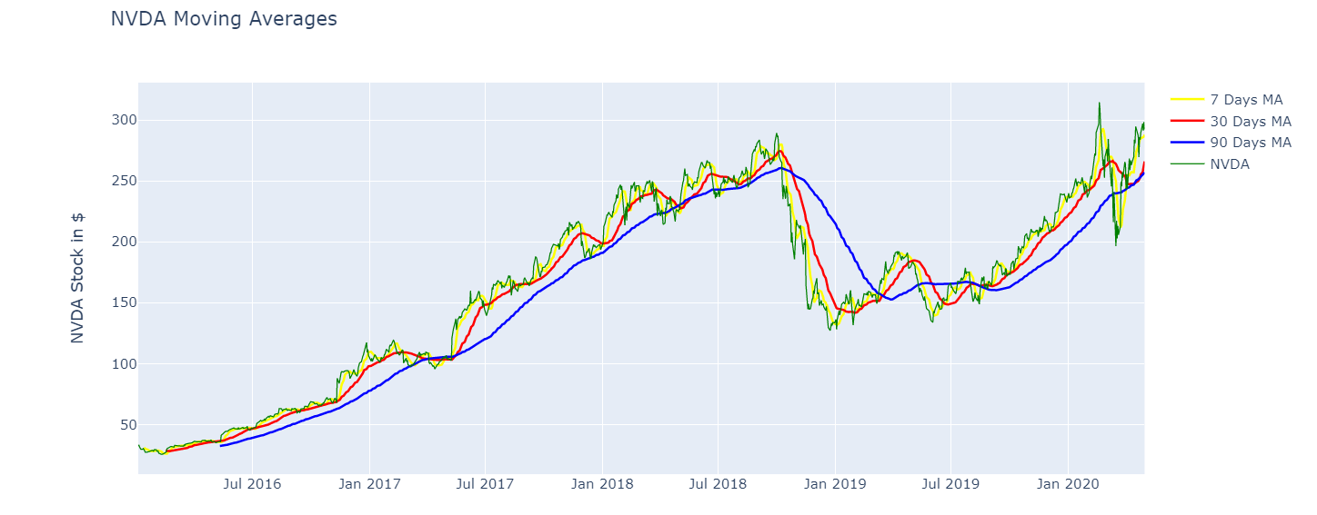
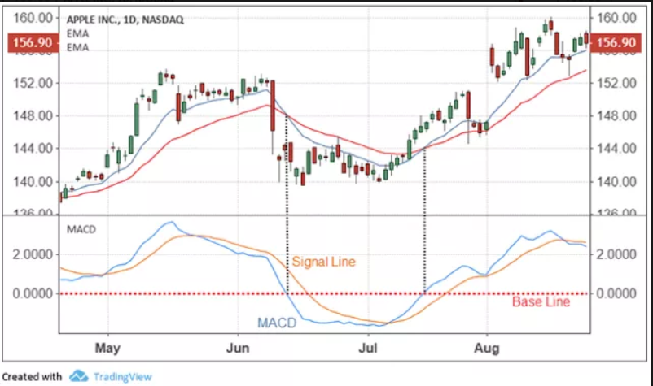
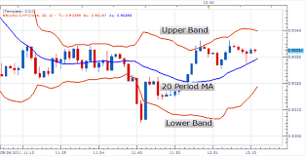
Moving Average of NVDA
Variants:
EMA
MACD
Bollinger Bands
200-SMA -- Most investors will look for a cross above or below this average to
represent if the stock is in a bullish or bearish trend.
Assumptions - The future data values will tend to follow the trend
Notes:
#Moving Average Visualization
PG['MA50']=PG['Adj Close'].rolling(50).mean()
PG['MA200']=PG['Adj Close'].rolling(200).mean()
PG[['Adj Close','MA50','MA200']].plot(label='P&G',figsize=(16,8));

Slide 16
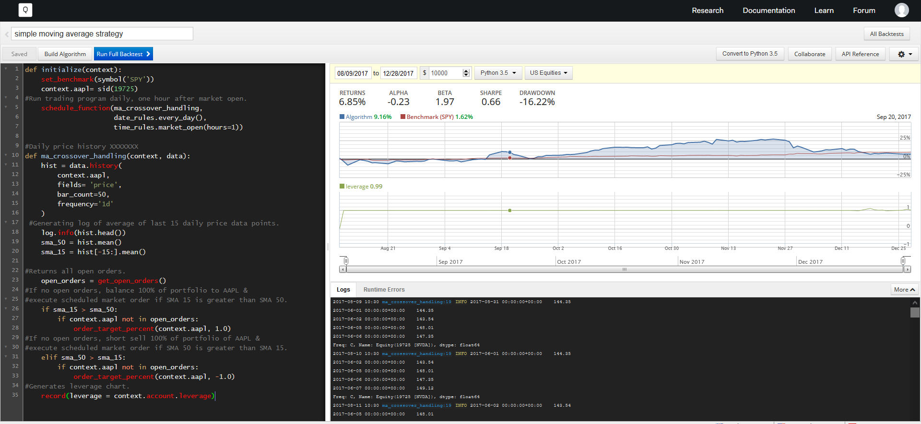

Slide 17
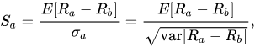
Backtesting Development
Sharpe Ratio: It is measuring the performance of an investment (e.g., a security or portfolio) compared to a risk-free asset, after adjusting for its risk.
here , Ra = Profit for P&G ;
Rb = Risk free rate (S&P 500 benchmark)
Sa > 1.0 :: considered acceptable to good by investors
Sa > 2.0 :: Very Good
Sa > 3.0 :: Excellent
Sa < 1.0 :: Sub-optimal
Sa < 0.0 :: Loss w.r.t. Benchmark
Average Returns: It is average return gained in percentage per trade.
Average Profit: It is average profit gained in percentage per trade.

Slide 18
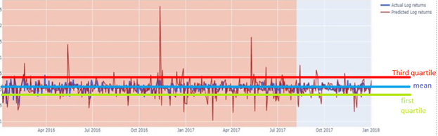
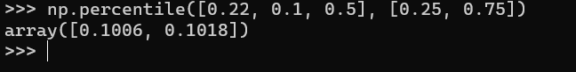
log returns
0.22
0.1
0.5
First quartile= 0.1006
Third quartile= 0.1018
Buy at first quartile =>
Log returns= log(current_price/ yesterdays_price)= 0.1006
Buy when current_price ≤ yesterdays_price* e^0.1006
Similarly sell when current_price ≥ yesterdays_price* e^0.1018

Slide 19
Machine Learning Models and Strategies
Linear Regression Models with /without Market Factors
Fama and French Models
PCA Features Model
Quadratic Model
Garch Model
Kalman Filter Model
Random Forest Model
Long Short Term Memory (RNN)

Slide 20
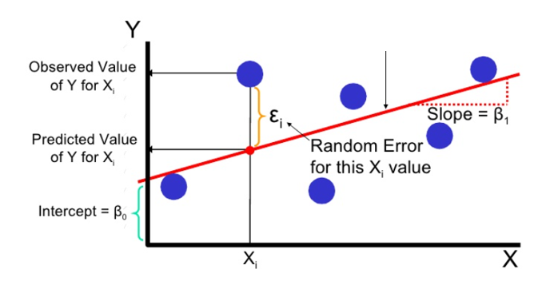
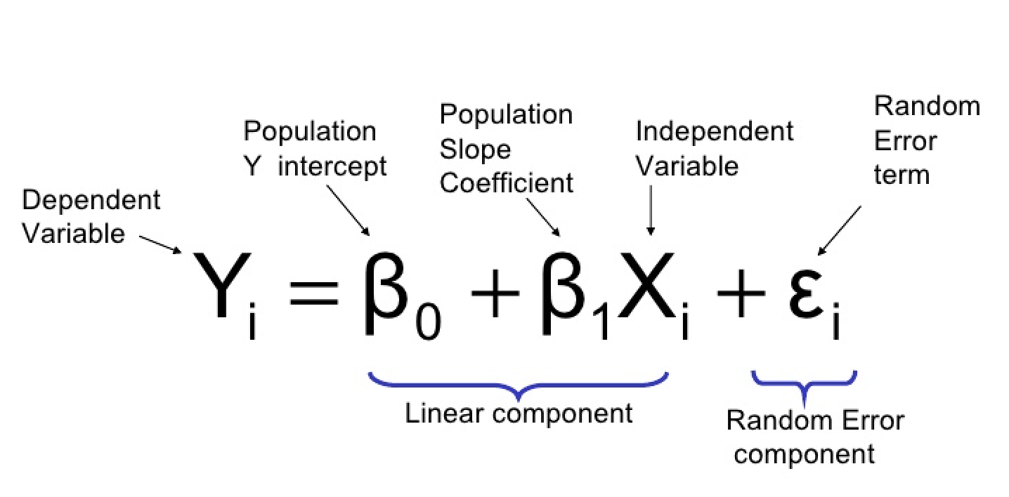
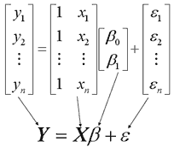
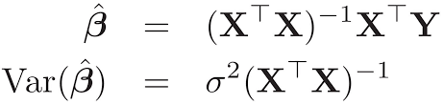
Linear Regression
Linear regression is a statistical measure to determine the relationship between a dependent variable and a series of independent variables
Mathematical Representation

Slide 21
Assumptions of Multi-variate linear regression analysis
Linear relationships, outlier/ Influential cases- The relationship between the independent and dependent variables to be linear. It is important to check for outliers as this method is sensitive to outlier effect. Relationship between features can be determined by using Scatterplots.
Multivariate Normality- The relationship requires all the variable to be multivariate normal i.e. the residuals are normally distributed
No Multicollinearity- Multiple regression assumes that there is less or no multicollinearity between the independent variables. Criteria to check multicollinearity are:
Correlation Matrix
Tolerance
Variance Inflation Factor
Homoscedasticity- This assumption states that the variance of error terms are similar across the values of the independent variables. The scatterplot is good way to check homoscedasticity.

Slide 22
The Fama-French model is an extension of the Capital Asset Price Model (CAPM).
The Fama-French model aims to describe stock returns through three factors:
Market risk,
Company Size – Outperformance of small vs big companies
Value Factor – Outperformance of high market vs small market companies
Mathematical Representation:
Where:
r = Expected rate of return
r_{f} = Risk-free rate
ß = Factor’s coefficient (sensitivity)
(r_{m} – r_{f}) = Market risk premium
SMB = Size Premium(small minus big)
HML = Value Premium (high minus low)
FAMA French Model

Slide 23
The key assumption on which Fama-French model is based on:
Small-cap high-value companies usually do better than the overall market
Higher investments usually lead to bigger and better returns
Value companies outperform growth companies
ß value - The beta of the investment measures the amount of risk the investment which resembles the market:
If the ß > 1, the stock is riskier than the market itself.
If the ß <= 1, the formula will assume that the risk of a portfolio will be reduced.

Slide 24
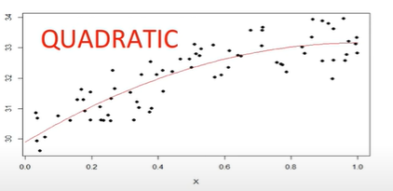
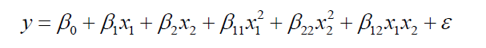
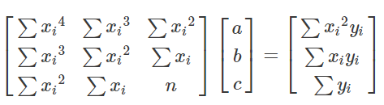
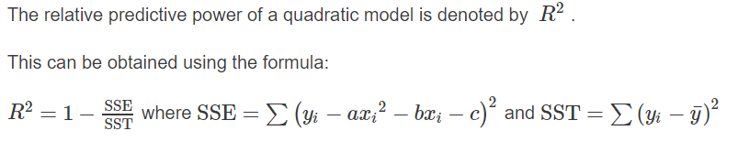
Polynomial Regression - Quadratic Model
This is form of Linear regression in which the relationship between independent variables and dependent variable is modelled as an nth degree polynomial
A quadratic regression is the process of finding the equation of the parabola that best fits a set of data. As a result, we get an equation of the form:
Mathematical Representation
The matrix equation for quadratic curve is given by:

Slide 25

Linear model with PCA Engineered Features
PCA is essentially a dimensionality reduction techniques that detects correlation and multicollinearity amongst many features and reduces them to 'n' new features in dimensions orthogonal to each previous dimensions of feature space.
These new feature keep the maximum/desired variance(spread of the data) of original data with summarizing in compact features with intertwined definitions and aid making similar interpretations and inferences as original data. The new features are usually called PCA1, PCA2 , ... and retain the highest variance of the data in decreasing order of their construction. i.e, PCA1 will the retain highest variance in the data and demarcates records/observations from each other most strongly than other PCA engineered features.
PCA also is able to identify hidden constraints of a data as it has policies of reconstructing original features from PCA engineered components. The new dimension of principal component PCA1 can be Z1 where : b₁ z₁ = a₁x₁ + a₂x₂
Clearly new components are linear combinations of original features.

Slide 26
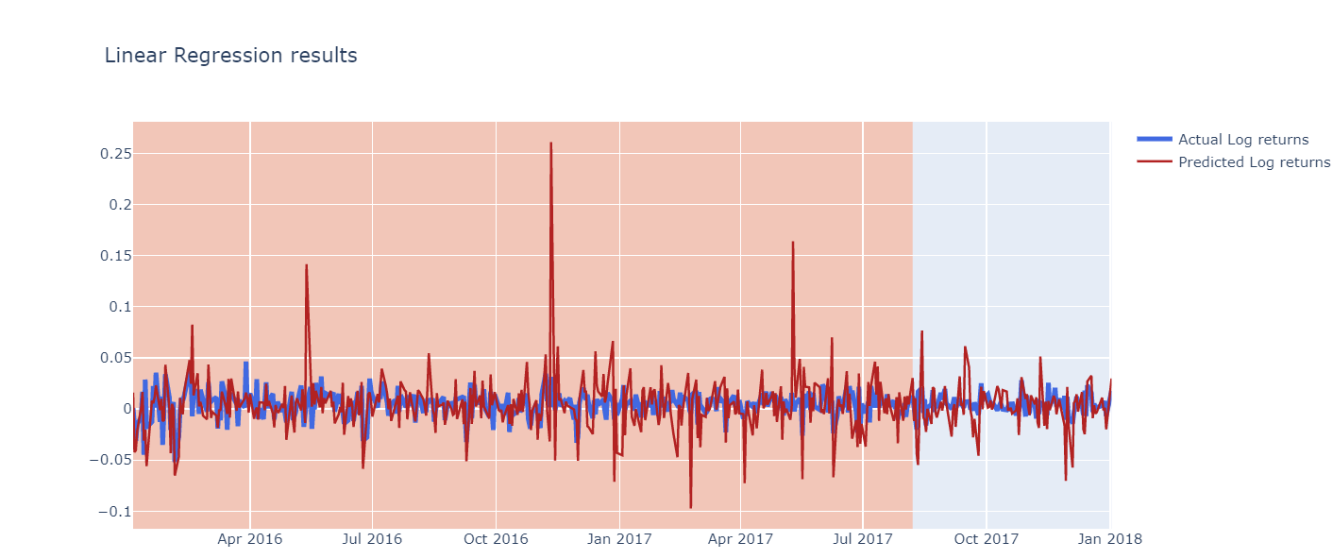
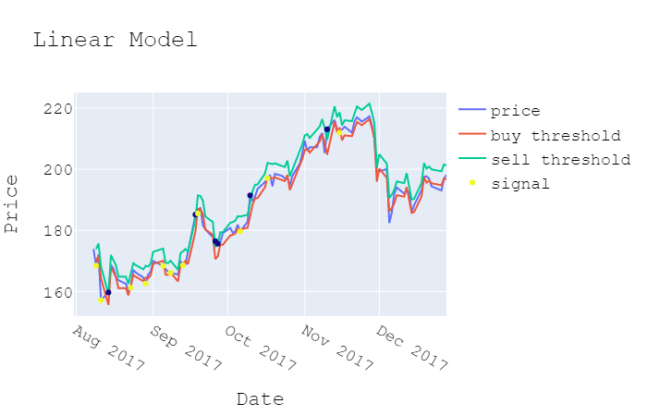
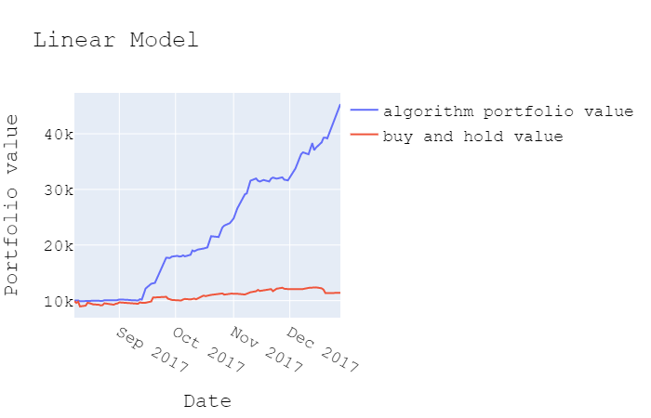
Linear Model Result
Parameters Used: 'Mkt-RF','SMB','HML','RMW','CMA','RF','ADS_Index','Log_Close'​

Slide 27
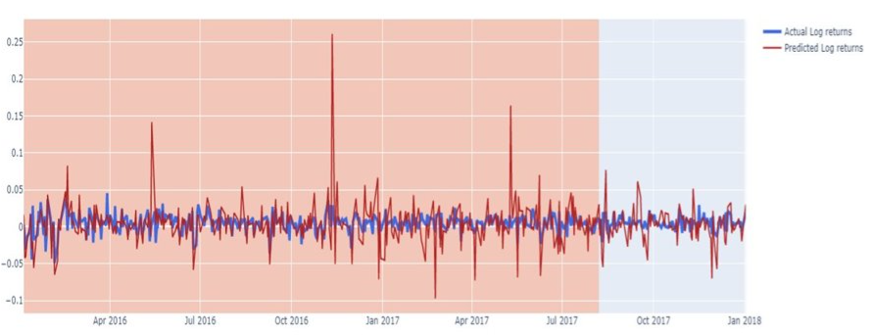

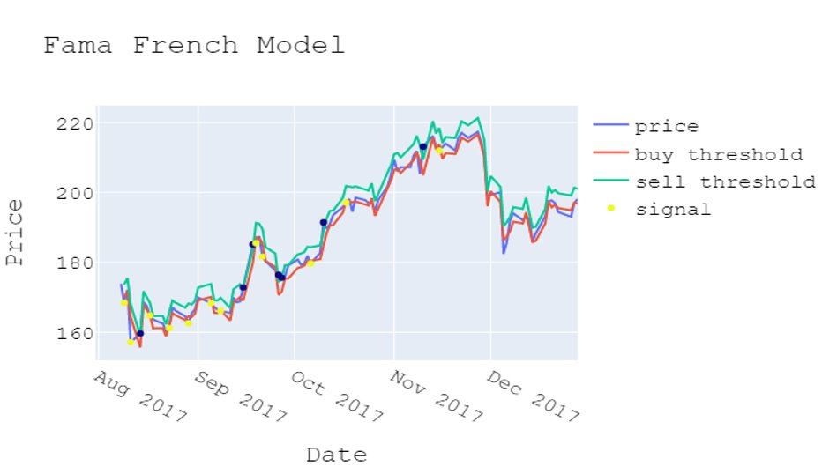
Fama – French Result

Slide 28
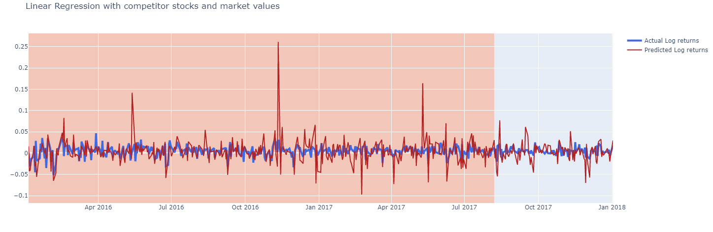
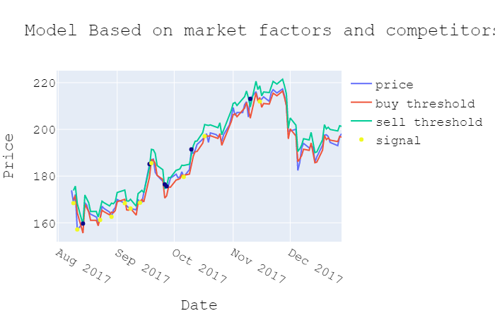
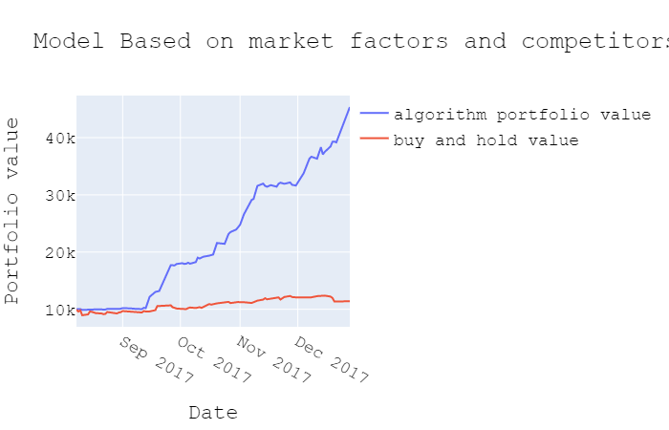
Linear Model on Market Factors and Competitor Returns
Features Used: 'Mkt-RF', 'SMB', 'HML', 'RMW', 'CMA', 'RF', 'ADS_Index', 'Close','QCOMClose', 'INTCClose','AMDClose', 'NASDAQClose', 'DJIClose', 'SPYClose'

Slide 29
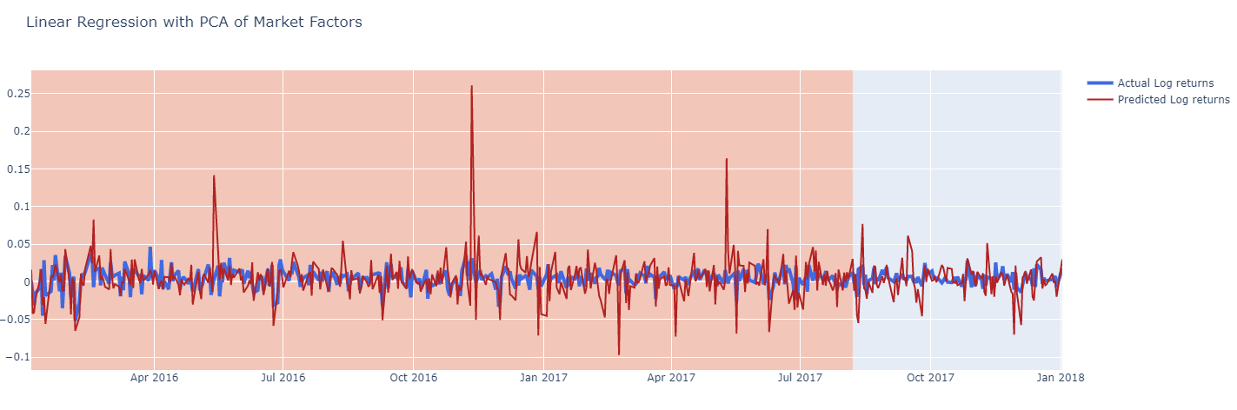

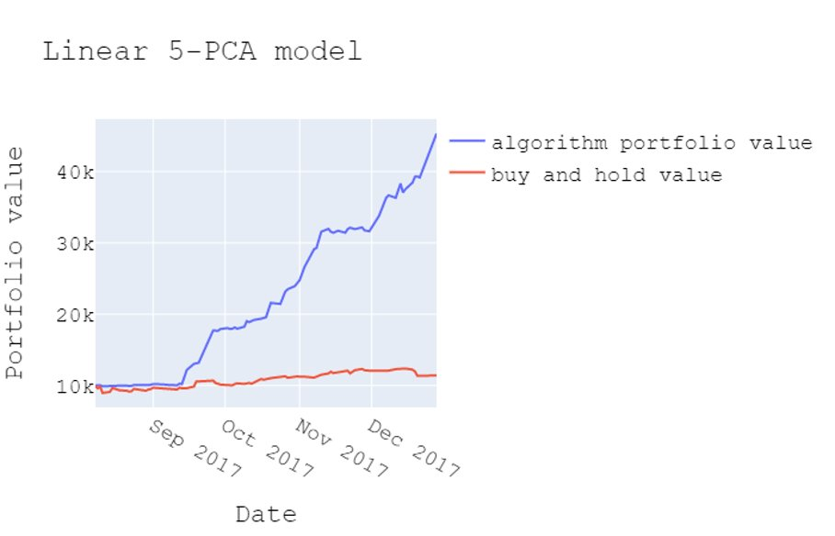
Total variables used: Mkt-RF', 'SMB', 'HML', 'RMW', 'CMA', 'RF', 'ADS_Index', 'Close', 'QCOMClose', 'INTCClose', 'AMDClose', 'NASDAQClose', 'DJIClose'
Reduced Dimensions with highest variance of dataset: 'pca1', 'pca2', 'pca3', 'pca4', 'pca5'

Slide 30
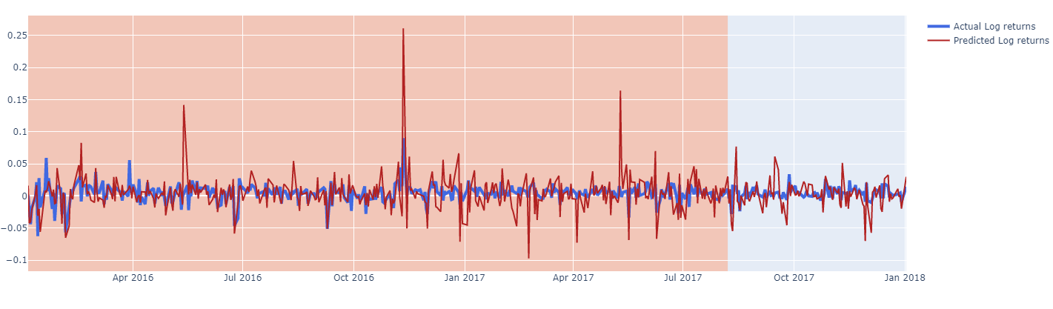
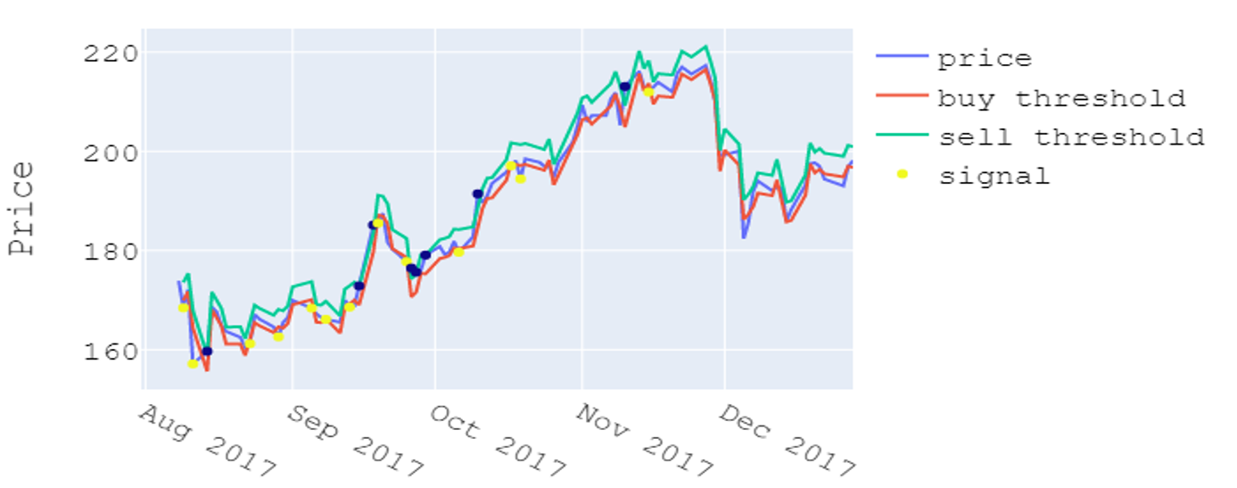
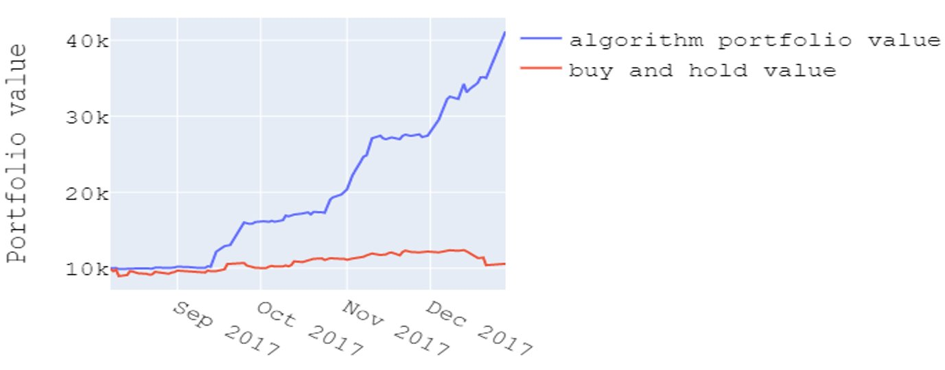
Quadratic Regression Results
Features Used : 'Mkt-RF', 'SMB', 'HML', 'RMW', 'CMA', 'RF', 'ADS_Index','Mkt-RF-sq', 'Mkt-RF_CMA', 'Mkt-RF_SMB', 'SMB-sq', 'RMW-sq'

Slide 31
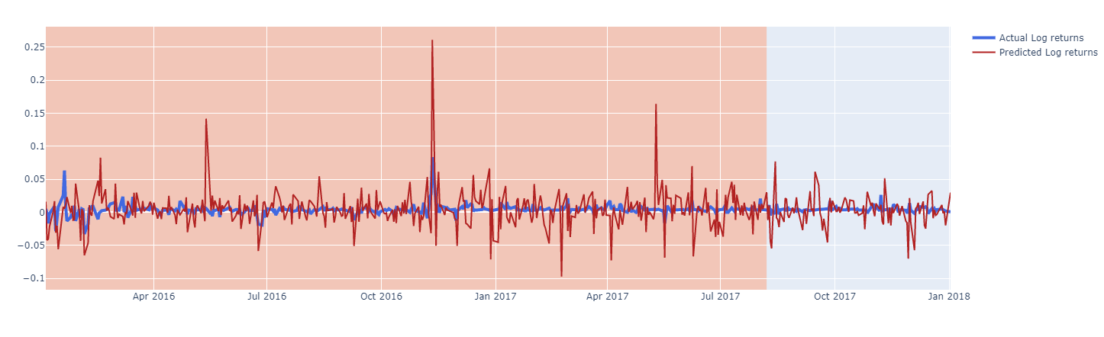
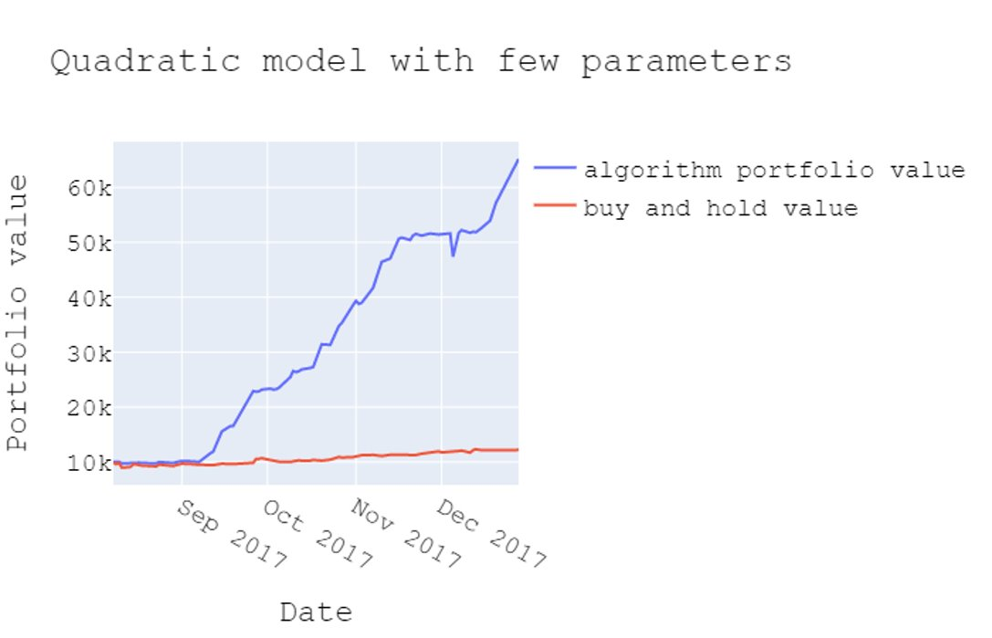
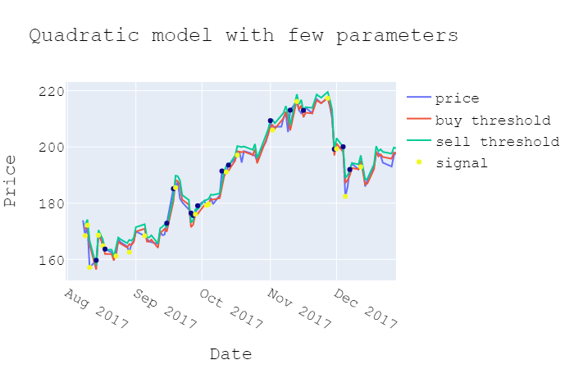
Quadratic Regression with few parameters results
Parameters Used: 'Mkt-RF-sq', 'Mkt-RF_CMA', 'Mkt-RF_SMB', 'SMB-sq', 'RMW-sq'

Slide 32
Results and Outputs
Accuracy | Linear Regression Model | Linear Regression with Market Factor | Linear Regression with PCA | Fama French Model
RMSE Value | 0.02352 | 0.02352 | 0.02352 | 0.02359
AIC Value | 938.730 | 938.730 | 938.730 | 938.732
BIC Value | 968.274 | 968.274 | 968.274 | 968.276

Slide 33
Results and Outputs
Accuracy | Quadratic Regression | Quadratic Regression with few parameters
RMSE Value | 0.02294 | 0.02564
AIC Value | 938.717 | 938.783
BIC Value | 968.274 | 968.274

Slide 34
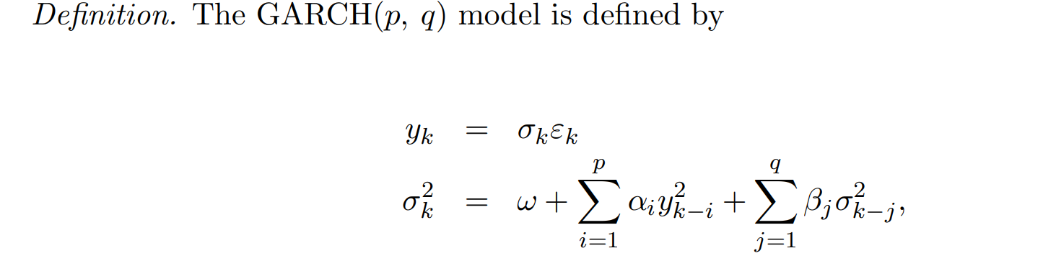
GARCH is a statistical modeling technique used to help predict the volatility of returns on financial assets.
GARCH is appropriate for time series data where the variance of the error term is serially autocorrelated following an autoregressive moving average process.
GARCH is useful to assess risk and expected returns for assets that exhibit clustered periods of volatility in returns.
Assumptions:
GARCH models assume that the variance of the error term follows an autoregressive moving average process.
The data must be stationary
GARCH Model

Slide 35
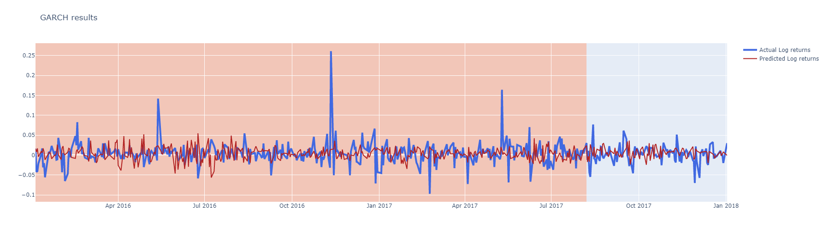
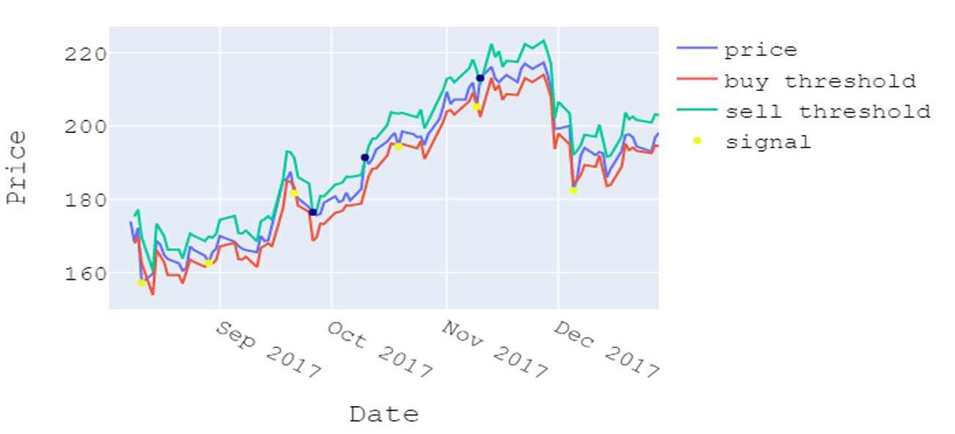
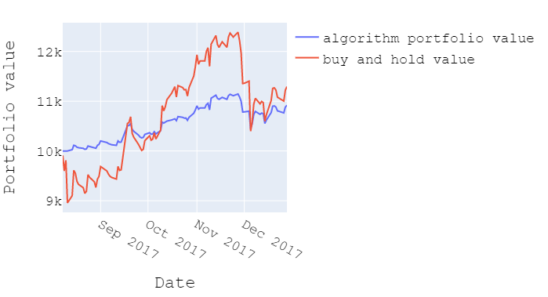
GARCH RESULT

Slide 36
Results and Outputs
Accuracy | GARCH
RMSE Value | 0.02943
AIC Value | 938.927
BIC Value | 968.471

Slide 37
Kalman filtering is an algorithm that provides estimates of some unknown variables given the measurements observed over time.
Kalman filters are used to estimate states based on linear dynamical systems in state space format.
The process model defines the evolution of the state from time k−1 to time k as:
x_{k}=Fx_{k−1}+Bu_{k−1}+w_{k−1}
where
F : the state transition matrix applied to the previous state vector x_{k−1}
B : the control-input matrix applied to the control vector u_{k−1}
w_{k−1} : the process noise vector that is assumed to be zero-mean Gaussian with the covariance Q
Assumptions:
Kalman filter assumes that the errors are Gaussian
Kalman Filter

Slide 38
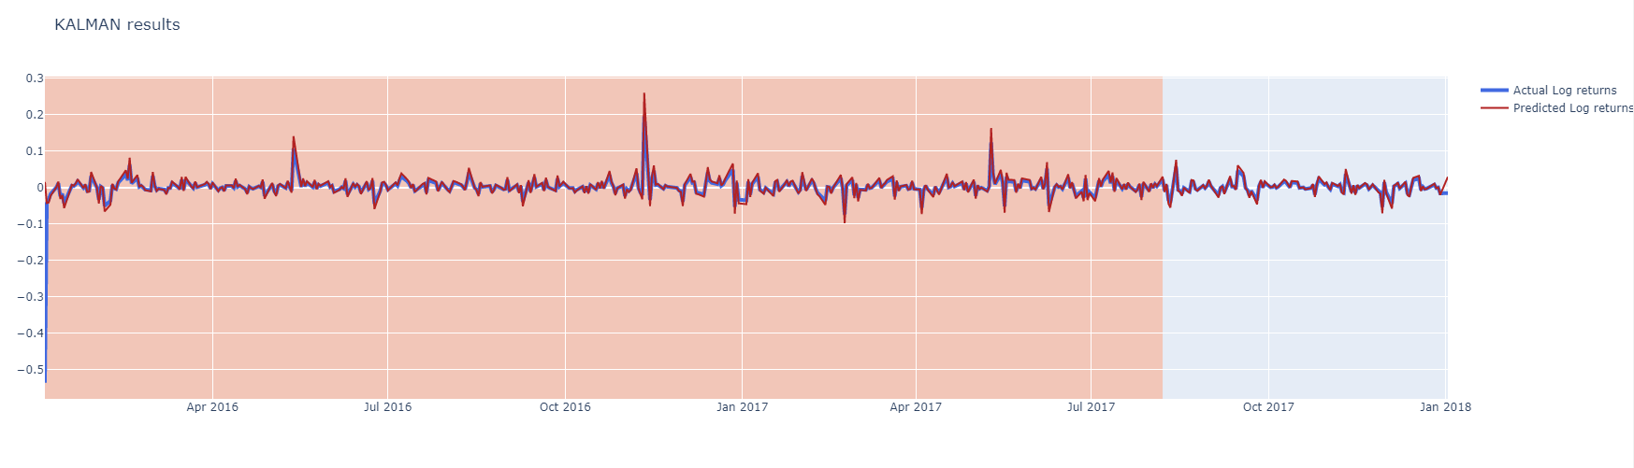


Kalman Filter Result

Slide 39
Results and Outputs
Accuracy | Kalman Filter
RMSE Value | 0.02553
Log Likelihood | 462.3900
AIC Value | 938.781
BIC Value | 968.324

Slide 40
Random Forest
Random Forest is a modified form of bagging that creates ensembles of independent decision trees.
To de-correlate the trees, we:
Train each tree on a separate bootstrap sample of the full training set
For each tree, at each split, we randomly select a set of J′ predictors from the full set of predictors.
Assumptions for Random Forest:
The only assumption that it relies is that sampling is representative

Slide 41



Random Forest results

Slide 42
Results and Outputs
Accuracy | Random Forest
RMSE Train | 0.02767
RMSE Test | 0.02179
Negative Log Likelihood | 369.56717
AIC | 753.13434
BIC | 781.10951

Slide 43

LSTM is a neural network architecture that extends the memory of recurrent neural networks.
It mitigates the vanishing gradient problem, which is where the neural network stops learning because the updates to the various weights within a given neural network become smaller and smaller.
Long Short Term
Memory(LSTM)
Assumptions for LSTM
LSTM assumes that the state at current time step depends on previous time step. This assumption constraints the time dependency modeling capability.

Slide 44



LSTM Results

Slide 45
Results and Outputs
Accuracy | LSTM
train rmse | 3.160789837904403
test rmse : | 3.331075916998535
AIC | 739.7955246450381
BIC | 756.6379249531367

Slide 46


STACKING

Slide 47
Financial Comparison of Models using Backtesting
 | LR | Quadratic | Quadratic2 | FF | GARCH | KF | 5-PCA | Competitors | LSTM | Average
SHARPE | 6.15 | 6.43 | 6.622 | 6.16 | 5.999 | 2.560 | 6.150 | 6.150 | 4.648 | 5.649
Beta | -0.209 | -0.655 | 1.015 | -0.627 | 0.296 | 0.705 | -0.209 | -0.209 | 1.071 | -0.9
Return% | 353.36 | 311.71 | 551.83 | 372.67 | 237.94 | 54.72 | 353.36 | 353.36 | 289.118 | 291.622

Slide 48
THANK YOU!!!!!!!

